Slide 1
Ethical Hacking
Mohona Ghosh

Slide 2
Backdoor
A backdoor, also known as a trapdoor, is a secret entry point into a program that allows someone that is aware of the backdoor to gain access without going through the usual security access procedures.
Generally, programmers use backdoors legitimately to debug and test programs. This usually is done when the programmer is developing an application that has an authentication procedure, or a long setup, requiring the user to enter many different values to run the application. To debug the program, the developer may wish to gain special privileges or to avoid all the necessary setup and authentication.
The programmer may also want to ensure that there is a method of activating the program should something be wrong with the authentication procedure that is being built into the application.
The backdoor is code that recognizes some special sequence of input or is triggered by being run from a certain user ID or by an unlikely sequence of events.
Backdoors become threats when unscrupulous programmers use them to gain unauthorized access.
It is difficult to implement security controls for backdoors

Slide 3
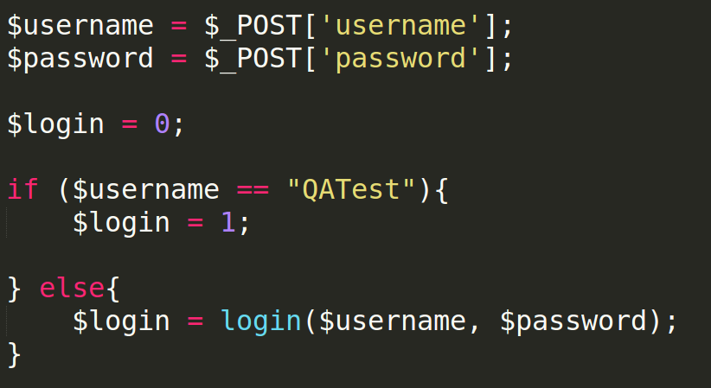
Backdoor Example
In this code, the username and password will be checked using the function login()
If the username is "QATest" access will be granted regardless of the password, otherwise it will be checked through the login function.
These types of backdoors are hard to detect and easy to forget. The developer has to make sure that the application doesn't go to production with these types of backdoors because hackers might use them to their advantage

Slide 4

Backdoor Example
Generally in cryptosystems, the secret key is generated using a pseudorandom number generator (PRNG)
Pseudo Random Number Generator (PRNG)
SEED
Move your mouse, press a keyboard button etc.
RSA based, Elliptic Curve based, block cipher based etc.

Slide 5
Backdoor Example
National Security Agency (NSA) motto: Generate key using a PRNG but with a trapdoor
Trapdoor will help predict the secret key
For Example - Dual_EC_DRBG (Dual Elliptic Curve Deterministic Random Bit Generator)
Supposed to implement a cryptographically secure pseudorandom number generator (CSPRNGs)
Despite public criticism on efficiency and security, it was for some time one of the four (now three) CSPRNGs standardized in NIST SP 800-90A
Allegedly included by NSA who had the knowledge of pre-installed backdoor in it

Slide 6
Backdoor Example
For Example - Dual_EC_DRBG (Dual Elliptic Curve Deterministic Random Bit Generator)
Backdoor: There is a problem if one chooses P and Q (constants that define the elliptic curve) randomly rather than Q = d. P where d is known (to NSA)
The P and Q’s were given in NIST draft without any explanation
Thus, NSA knew the secret key; but for others factoring Q and P to get ‘d’ is a hard problem !!!
If you know this “d”, you can determine the internal state of the random number generator from looking at the output from a single round (32 bytes)
All future outputs of the random number generator can then easily be calculated, until the CSPRNG is reseeded
NIST RECOMMENDATION: The security of Dual_EC_DRBG requires that the points P and Q be properly generated. However, to avoid using potentially weak points, the points specified in Appendix A.1 are advised to be used.

Slide 7
Trojans

Slide 8
Trojans

Slide 9
Trojans create a covert communication channel between victim computer and attacker for transferring sensitive data.

Slide 10
Trojans

Slide 11
Different Ways a Trojan can gain Entry
http://www.guninski.com/browsers.html

Slide 12
Different Ways a Trojan can gain Entry

Slide 13

Trojans Example
In this case, a Trojan horse is used to get around the standard security mechanism used by most file management and operating systems: the access control list
In this example, a user named Bob interacts through a program with a data file containing the critically sensitive character string "CPE170KS."
User Bob has created the file with read/write permission provided only to programs executing on his own behalf: that is, only processes that are owned by Bob may access the file.

Slide 14

Trojans Example
The Trojan horse attack begins when a hostile user, named Alice, gains legitimate access to the system and installs both a Trojan horse program and a private file to be used in the attack as a "back pocket."
Alice gives read/write permission to herself for this file and gives Bob write-only permission.
Alice now induces Bob to invoke the Trojan horse program, perhaps by advertising it as a useful utility (e.g., a new text editor).
When the program detects that it is being executed by Bob, it reads the sensitive character string from Bob's file and copies it into Alice's back-pocket file .
Both the read and write operations satisfy the constraints imposed by access control lists
Alice can then access the bad pocket file to learn the value of the string

Slide 15
Different Ways a Trojan can gain Entry

Slide 16
Different Ways a Trojan can gain Entry

Slide 17


Trojans

Slide 18

Trojans

Slide 19
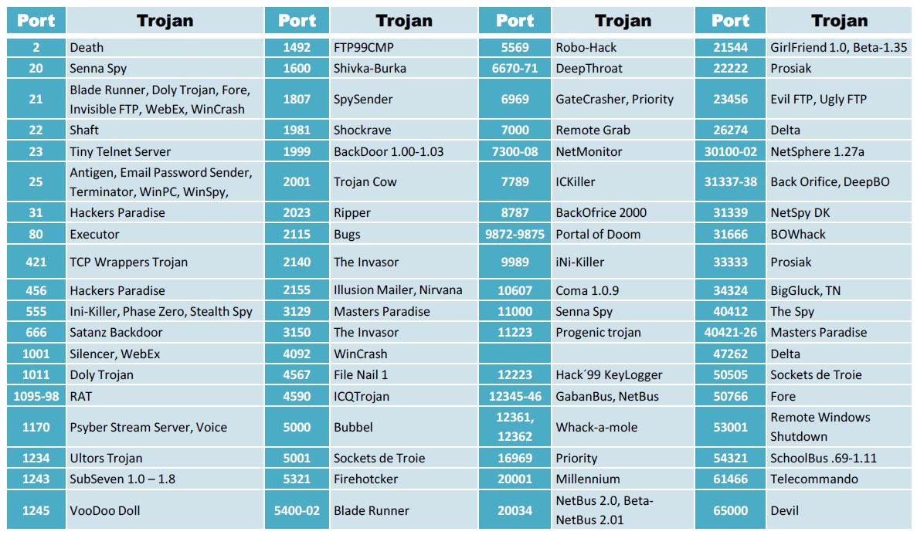


Common Ports infected by Trojans
Just as HTTP server listens on to port 80 for any new web requests, similarly ,Trojans listen to various ports to make new connections with other hosts
Some Trojans use more than one port as one port may be used for "listening" and the other(s) for data transfer.
E.g, FTP Trojans install an FTP server on the victim's machine, which opens FTP ports. An attacker can then connect to the victim's machine using FTP port to download any files that exist on the victim's computer.

Slide 21
How to infect system using Trojans
An interesting example of a modern dropper is OnionDuke (discovered in 2014), carried by infected Tor nodes. It is a wrapper over legitimate software. When a user downloads software via an infected Tor proxy, OnionDuke packs the original file and adds a malicious stub to it. When the downloaded file is run, the stub first downloads malware and installs it on a computer, and then unpacks the legitimate file and removes itself in order to be unnoticed.
Example of a Dropper:
Installation path: c:\windows\system32\svchosts.exe
Autostart: HKLM\Software\Mic...\run\Iexplorer.exe

Slide 22



Trojan Wrappers
Behind the original program, a Trojan has 3 parts:
Dropper: This is the code which installs malicious code into the target.
Malicious code: This is the code which exploits the system and gives the attacker control over the target.
Wrapper: Wrapper wraps dropper, malicious code, genuine code into one exe package.
When victims try to download an infected file, dropper installs the malicious code first and then the genuine program.

Slide 23



Trojan Structure
Dropper:
Installation path: c:\windows\system32\svchosts.exe
Autostart: HKLM\Software\Mic...\run\Iexplorer.exe
Malicious code:
Password cracker
A genuine application:
File name: chess.exe
Wrapper data: Executable file

Slide 24

Types of Trojan
HTTP Trojan
HTTPS Trojan
ICMP Trojan
FTP Trojan
Data Hiding Trojan
Destructive Trojan
Botnet Trojan
Proxy Server Trojan
Remote Access Trojan
Defacement Trojan
E-banking Trojan
Covert Channel Trojan

Slide 25

Trojan Countermeasures

Slide 26

Trojan Countermeasures

Slide 27

Trojan Countermeasures

Slide 28


Anti Trojan Software

Slide 29


